Slide 1




Corporate Blockchain Platforms Hyperledger
Public and Private chains, Introduction to Hyperledger
Solidity
SoftUni Team
Technical Trainers
Software University
http://softuni.bg

Slide 2

Table of Contents
Type of Blockchains
Public
Private
Pros and Cons
Hyperledger

Slide 3

Public and Private Blockchains

Slide 4
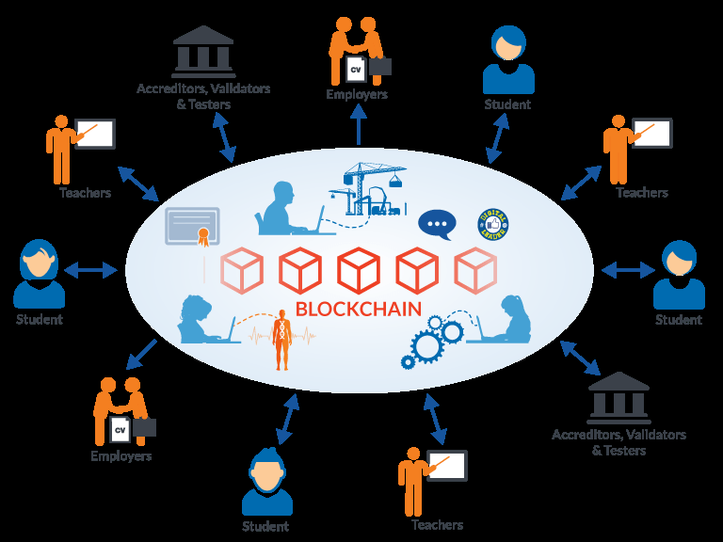
Public Blockchain
Consensus algorithm
based on PoW or PoS
Anyone is able to join
Every user may read
the blockchain info
and write to the blockchain
Unknown parties

Slide 5





Examples of a Public Blockchain
Bitcoin
Ethereum
Monero
Dash
Litecoin

Slide 6

Private Blockchain
No computionally
heavy consensus algorithms
Permission needed
to read and write
transactions
Known parties

Slide 7



Examples of a Private Blockchain
R3 – Banking sector
EWF – Energy sector
B3i – Insurance sector

Slide 8
Pros and Cons of the Public Blockchain
Pros:
Open
Secure
Cons:
Slow
Too open and transparent for some use cases
Could require a lot of energy to function properly
Not scalable

Slide 9
Pros and Cons of the Private Blockchain
Pros:
Low transaction costs
Simplifies the document handling
Fast
Scalable
Cons:
Privately owned
Managed upkeep
If not designed properly might fallback to a centralised network with a single point of failure

Slide 10
Private/Permissioned and Public/Permissionless Blockchain
Private
Participants are known and trusted
Legal contracts can replace system mechansms
Not a „trustless“ system
Public
No authoritative permission required to participate
Participants are not vetted
Mechanisms for maintaining the network agains attacks and unwanted parties increase cost and complexity

Slide 11

Hyperledger
Sawtooth, Iroha, Burrow, Indy

Slide 12

What is Hyperledger?
Open source global collaboration
Hosted by The Linux Foundation
Created to advance cross-industry blockchain technologies

Slide 13


Slide 14

Hyperledger`s Goals
Create enterprise grade,
open source,
distributed ledger frameworks
Build technical communities
to develop blockchain solutions
Educate the public
about the market opportunity
for blockchain technology

Slide 15




Hyperledger
Sawtooth
Iroha
Burrow
Indy

Slide 16
Hyperledger Sawtooth
A modular platform for building, deploying, and running distributed ledgers
Includes a novel
consensus algorithm,
Proof of Elapsed Time (PoET)
Targets large distributed validator populations with minimal resource consumption

Slide 17


Slide 18
Hyperledger Iroha
Business blockchain framework
Simple and easy to incorporate into infrastructural projects
It features:
A simple construction
Domain-driven C++ design
Emphasis on mobile application development
New, chain-based Byzantine Fault Tolerant consensus algorithm, called Sumeragi

Slide 19
Hyperledger Burrow
Provides a modular blockchain client
Permissionable smart contract machine with smart contract interpreter
Built in part to the specification of the
Ethereum Virtual Machine

Slide 20
Hyperledger Indy
A distributed ledger
Purpose-built for decentralized identity
Provides tools, libraries, and reusable components for creating and using independent digital identities rooted on blockchains or other distributed ledgers

Slide 21

Hyperledger Tools
Cello, Composer, Explorer, Quilt

Slide 22
Hyperledger Cello
Aims to bring the on-demand “as-a-service” deployment model to the blockchain ecosystem
Reduces the effort for:
Creating a blockchain
Managing a blockchain
Terminating a blockchain
Provides a multi-tenant chain service efficiently and automatically on top of various infrastructures

Slide 23
Hyperledger Composer
Tool for building blockchain business networks
Accelerating the development of smart contracts and their deployment
Built with JavaScript

Slide 24
Hyperledger Explorer
Designed to create a user-friendly Web application
Used for:
Viewing
Invoking
Deploying
Quierying
data stored in the ledger

Slide 25
Hyperledger Quilt (Coming Soon)
Going to offer interoperability between ledger systems
Designed to transfer value across distributed ledgers and non-distributed ledgers

Slide 26
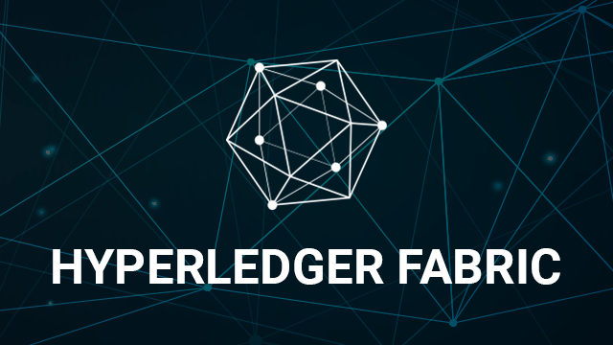
Hyperledger Fabric
Channels, Peers, Orderers, MSP, Policy, Chaincode

Slide 27

What is Hyperledger Fabric?
Foundation for developing applications or solutions with a modular architecture
Allows components, such as consensus and membership mervices, to be plug-and-play

Slide 28


Slide 29
Hyperledger Fabric`s Key Features
Channels for sharing confidential information
Ordering Service delivers transactions consistently to peers in the network
Endorsement policies for transactions
CouchDB world state supports wide range of queries
Bring-your-own Membership Service Provider (MSP)

Slide 30
Hyperledger Fabric Transaction Validation
No mining
Different consensus algorithm that:
Guarantees block immutability
Prevents double spending
Keeps proper ordering

Slide 31
Hyperledger Fabric Infrastructure
Distributed by design
Tools that:
Limit the visibility of the data
Prevent sensible data to be replicated by a particular party
The ledger stores every executed operation and information connected to it:
Certificates
Users

Slide 32
Hyperledger Fabric Infrastructure (2)
Highly customisible:
May be used as a private network
May be opened to all
No specific hardware requirements
Not vulnarable to a 51% attack

Slide 33

Exercise: Built a Network

Slide 34
Hyperledger Fabric Components
Certificate Authority
Channels
MSP
Peer
Ordering service
Chaincode and Policies

Slide 35
Certificate Authority
Every single operation that is executed inside Hyperledger fabric must be cryptographically signed with a certificate
A user may generate it using OpenSSL
A third party may be used to generate the sertificate
The standrad is X509
The CA is created to generate the necessary certificates

Slide 36
Certificate Authority (2)
Every user has its own certificate
Inside it additional information (attributes) can be placed:
Roles
Account number
The information is propagated through the system so that the chaincode (smart contract) may read it and make a decision

Slide 37
Channels
Used for data isolation – a separate instance of Hyperledger Fabric
Data cannot be exchanged between channels
They have different set of:
Rules
Policies
Chaincodes(smart contracts)
If a party is to join a channel, all exesting parties must agree

Slide 38
Membership Service Providers
A set of cryptographic materials that defines the organization
These certificates are different that the ones created by the CA
Only parties that share common MSP properties can see and communicate with each other
When a channel is configured it is specified who is allowed to participate in it
Into the channel’s configuration block are placed the public keys/certificates

Slide 39
Peers
This is where the ledger resides
The number of peers depends on the choice of structure
Through them data is queried and added
A peer may be a part of many channels
To create a backup of the ledger you need to backup the peer
All peers communicate automatically
If additional throughput is required simply more peers are added

Slide 40
Ordering service
The heart of the consensus algorithm
Provides order of operations
Creates the blocks
Sends the ready blocks to the peers
Decides which operation has precedence
Use one ordering service only for development

Slide 41

Exercise: Built an App

Slide 42
Chaincode
Represents a smart contract in the context of Hyperledger Fabric
Its main responsibility is to read and update the blockchain data
The peer executes the chaincode
The chaincode must be part of a channel
Inside a channel many different chaincodes may coexist
The chaincode must be installed on every single peer and then instantiated
After instantiation a policy must be provided

Slide 43
Policy
When an operation is executed it must be verified before being written inside the ledger
In order for the transactin to be verified it may be required that:
Every peer verifies it
A majority of peers verify it
A majority plus a certain peer varify it
A single peer verify it
Every policy concerns a single chaincode

Slide 44
Transaction Propagandation
Transaction proposed to the peers by the SDK
The peers simulate the transaction
The peers sign the transaction and send an endorsement response back to the SDK
The SDK takes all the endorsement responses, packs them into an invocation request which is send to the orderer
The orederer verifies if all conditions are met
The orderer instructs peers to update the ledger

Slide 45

Exercise: Chaincode with Go

Slide 46

Summary
Types of Blockchains:
Public
Private
Their pros and cons
Hyperledger projects
Hyperledger fabric
Network
App
Chaincode

Slide 47
Resources and Further Reading
Public and Private Blockchains – https://www.ibm.com/blogs/blockchain/2017/05/the-difference-between-public-and-private-blockchain/
Hyperledger – https://www.hyperledger.org/
Hyperledger Fabric Official Documentation – https://hyperledger-fabric.readthedocs.io/en/release/

Slide 48

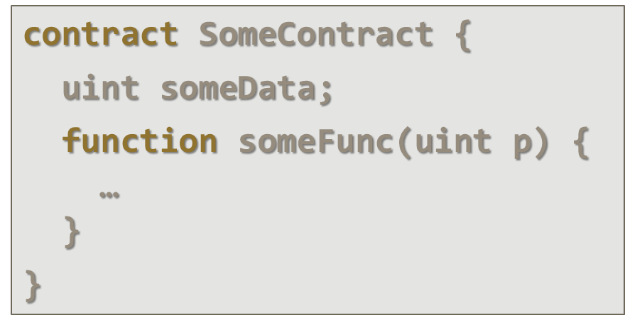


First Steps in Solidity
https://softuni.bg/courses/

Slide 49
License
This course (slides, examples, demos, videos, homework, etc.) is licensed under the "Creative Commons Attribution-NonCommercial-ShareAlike 4.0 International" license

Slide 50




Trainings @ Software University (SoftUni)
Software University – High-Quality Education, Profession and Job for Software Developers
softuni.bg
Software University Foundation
softuni.org
Software University @ Facebook
facebook.com/SoftwareUniversity
Software University Forums
forum.softuni.bg

